Slide 1
Data Analysis Exercise
BIKE SHARE PROGRAM
-SURBHI SHARMA

Slide 2
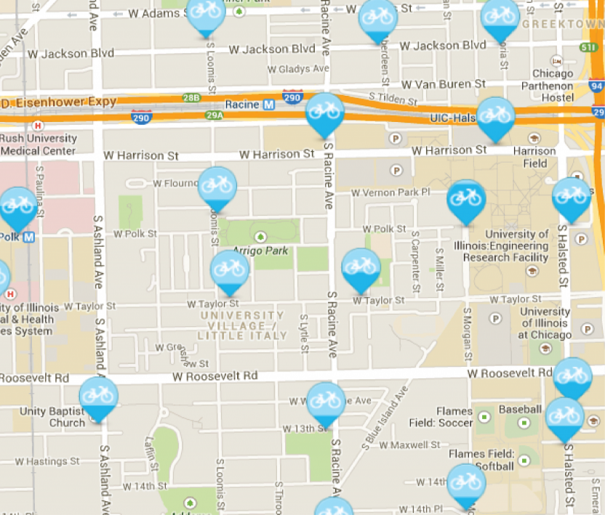
Data Analysis Exercise | Bike Share Program
Exercise Summary:
The
Client
A bike sharing program operating a system of docking stations & fleet of rental bikes in Boston
Key
Objective
The bike share program is seeking inputs to inform the development of their new mobile app
The joint goals of the app will be to promote loyalty and increase regular usage
Our task is to use data to analyze key customer segments, usage drivers, and demand factors
We will then use these analyses to recommend app features, target audiences, and incentive structures
Data Sources
We have been given the following data sources for the analysis:
Station data (i.e., location)
Trip data (i.e., start and end time)
Weather data

Slide 3
Data Analysis Exercise | Bike Share Program
Data Validation
Data Analysis
Data Visualization
1
2
3
What fields are the unique identifiers for each dataset?
What anomalies do you observe in each dataset?
Are there any additional data elements that you would ask the client for to make your analysis more thorough or meaningful?
For each station, calculate the following and be prepared to show your work:
Total Number of Rides
Average Duration of Rides
Average User Age
Distribution of Gender
Distribution of Subscription Type
Determine whether there is a correlation between weather temperature and the number of rides taken.
Graph the following views:
Chart of the average ride duration by age and gender.
Chart of the share of registered and casual users by day.
Assuming all stations began July 14th with 20 bikes, create a chart for any station (you pick) that shows the number of bikes available at the end of each day for the rest of July.

Slide 4
Data Validation
Unique Identifiers for each dataset –
Anomalies in each dataset –
Station Data | Trip Data | Weather Data
The Station ID i.e the “id” column | Create unique identifier by combining the trip_id, start_date, and end_date columns | The Date Column
Station Data | Trip Data | Weather
Duplicate values in id column Missing values in the status column Same terminal name in “terminal” column Same station name in station column The id = 137 have 'Porter' in both lat and lng column, and id = 138 have 'Ball Square' in both lat and lng columns. | Duplicate values Missing values in bike_nr, zip_code, gender, and birth_date columns Date without year in both start_date and end_date columns Inconsistent date formats in end_date column Some trip_ids have end date less than the start date | Missing values in Events column Precipitation_In column have two T value

Slide 5
Additional data elements for client for to make the analysis more thorough or meaningful -
Clarifying Questions | Additional Data Elements
What is the Age Limit for accessing these services? Are these birth years and genders verified? Do they generate anonymous bike ids? What is the process for casual users to rent a bike? What kinds of different bikes there are to offer the users? | Station List Zip Codes Purpose of renting bikes for registered users Address of registered users More demographic information on casual users More information such as bike did not work, transaction failed, technical issue with the page or browser, and the bike timer discrepancy

Slide 6
Key Findings from Data Analysis
Total Number of Rides are 1977
Total Number of Registered Users are 527
Total Number of Casual Users are 1450
Average trip time is 42.6 Mins
Average age of Users is 41.97 ~ 42 years
Registered Users –
- Males are 321
- Females are125
- Other are 76
Maximum number of rides are from Boston Public Library - 700 Boylston St.
Minimum number of rides are from Beacon St/Mass Ave
Maximum average age from New Balance - 38 Guest St. is 66 years
Minimum average age from Harvard University Housing - 111 Western Ave. at Soldiers Field Park and Harvard Real Estate - Brighton Mills - 370 Western Ave is 31 years
Maximum trip time is from Seaport Hotel
Minimum trip time is from Colleges of the Fenway

Slide 7
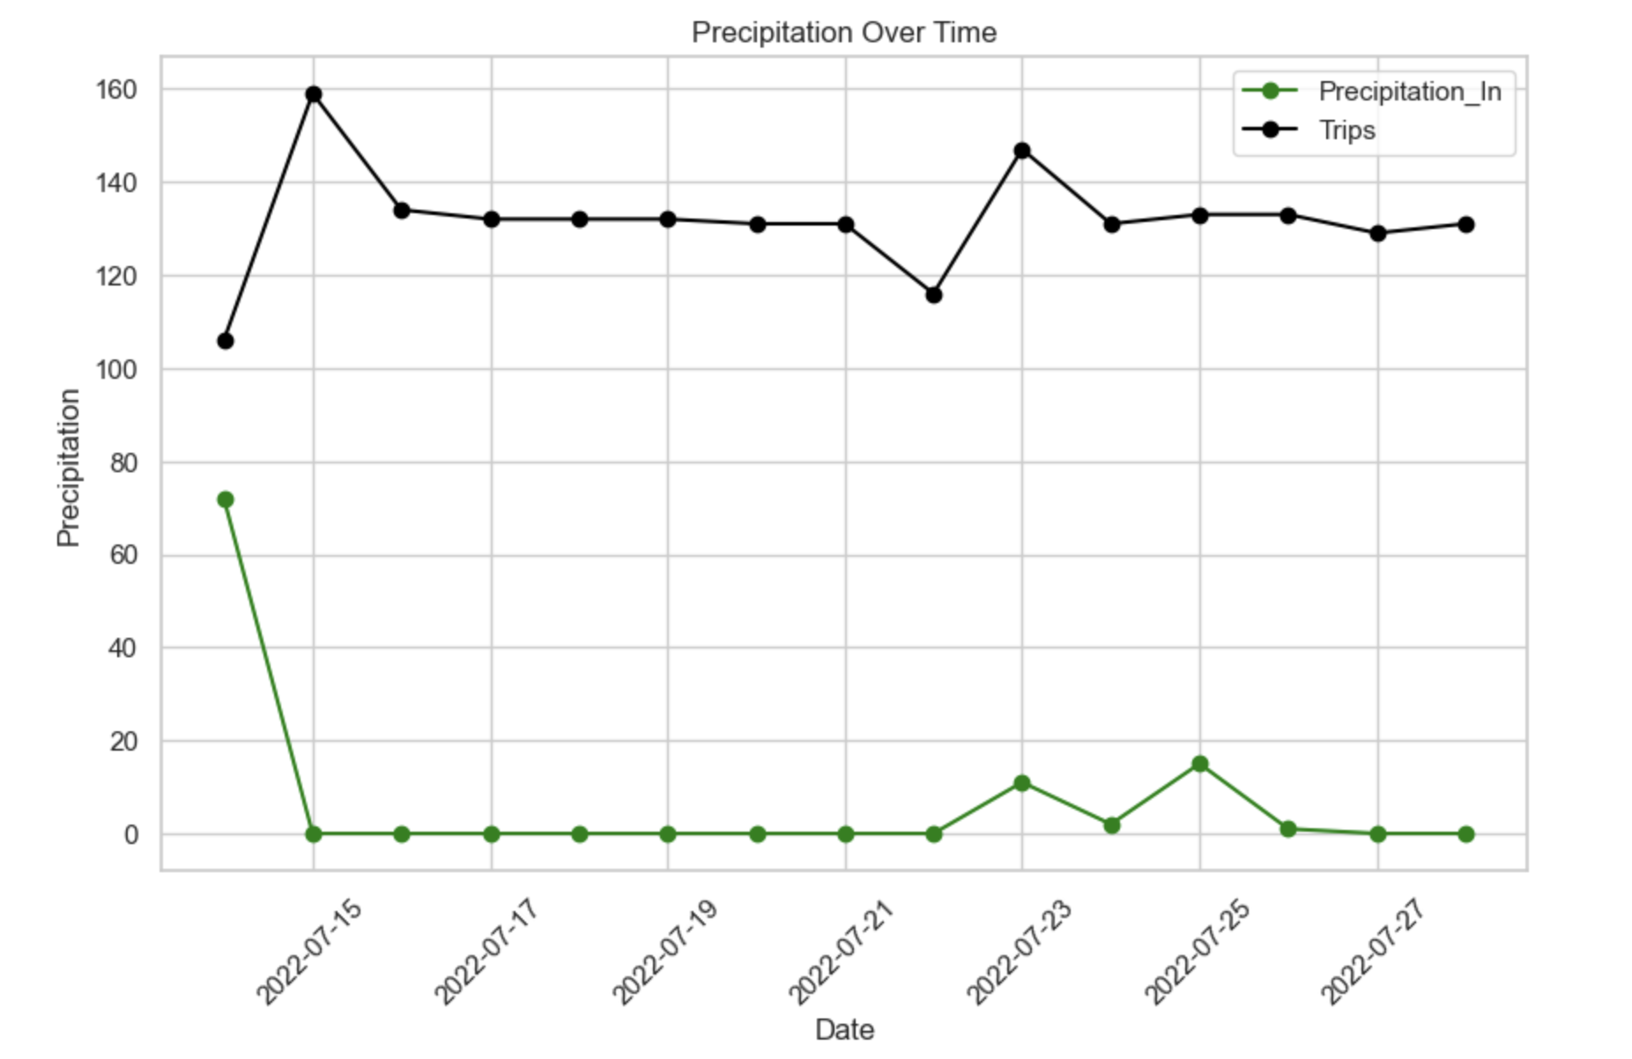
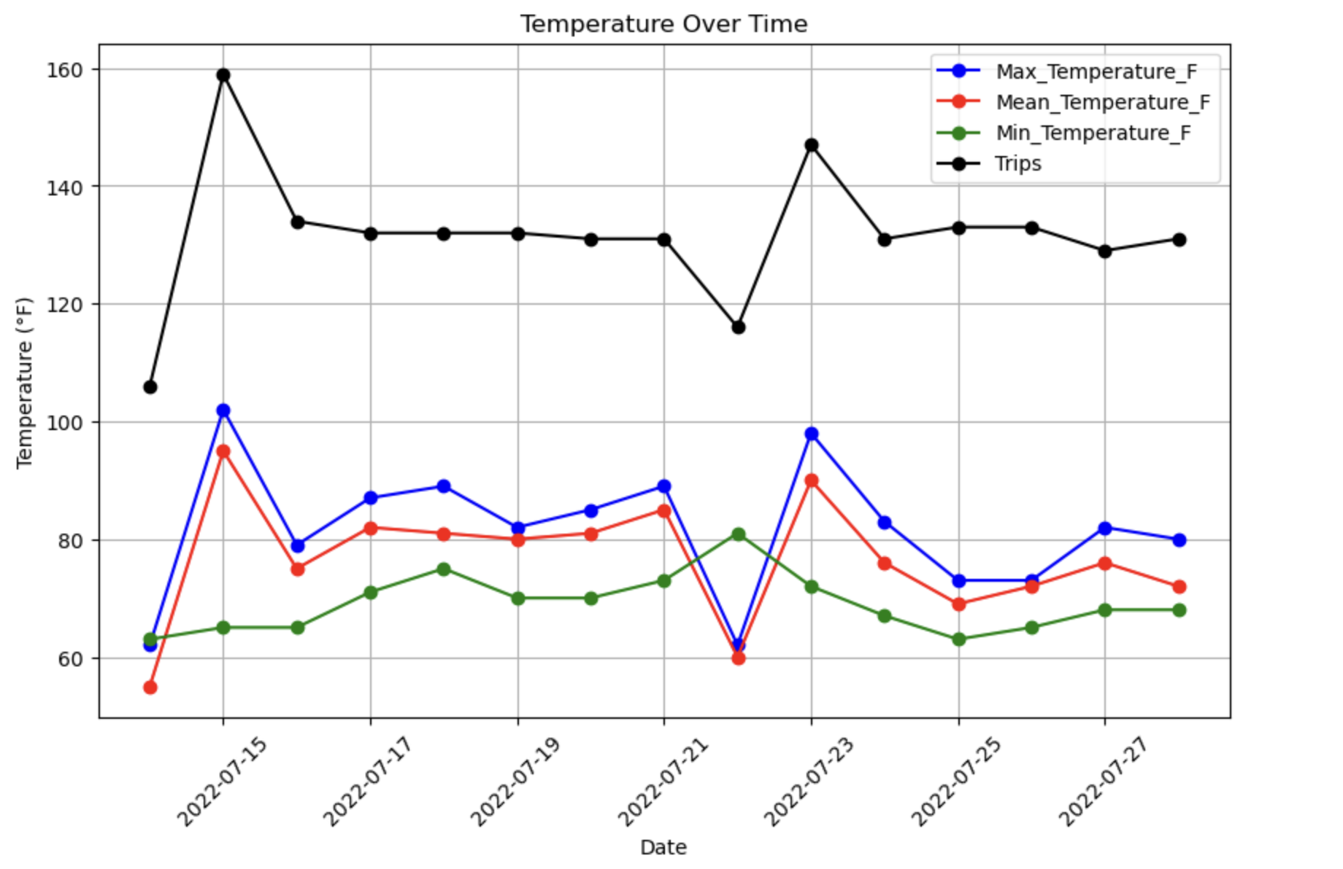
Weather Correlation with Number of Trips
Correlation between Precipitation and Number of Rides: -0.55.
The value of -0.55 indicates a moderate negative correlation between precipitation and the number of rides.
Correlation between Mean Temperature and Number of Rides: 0.88.
The value of 0.88 suggests a strong positive relationship between mean temperature and the number of rides.

Slide 8
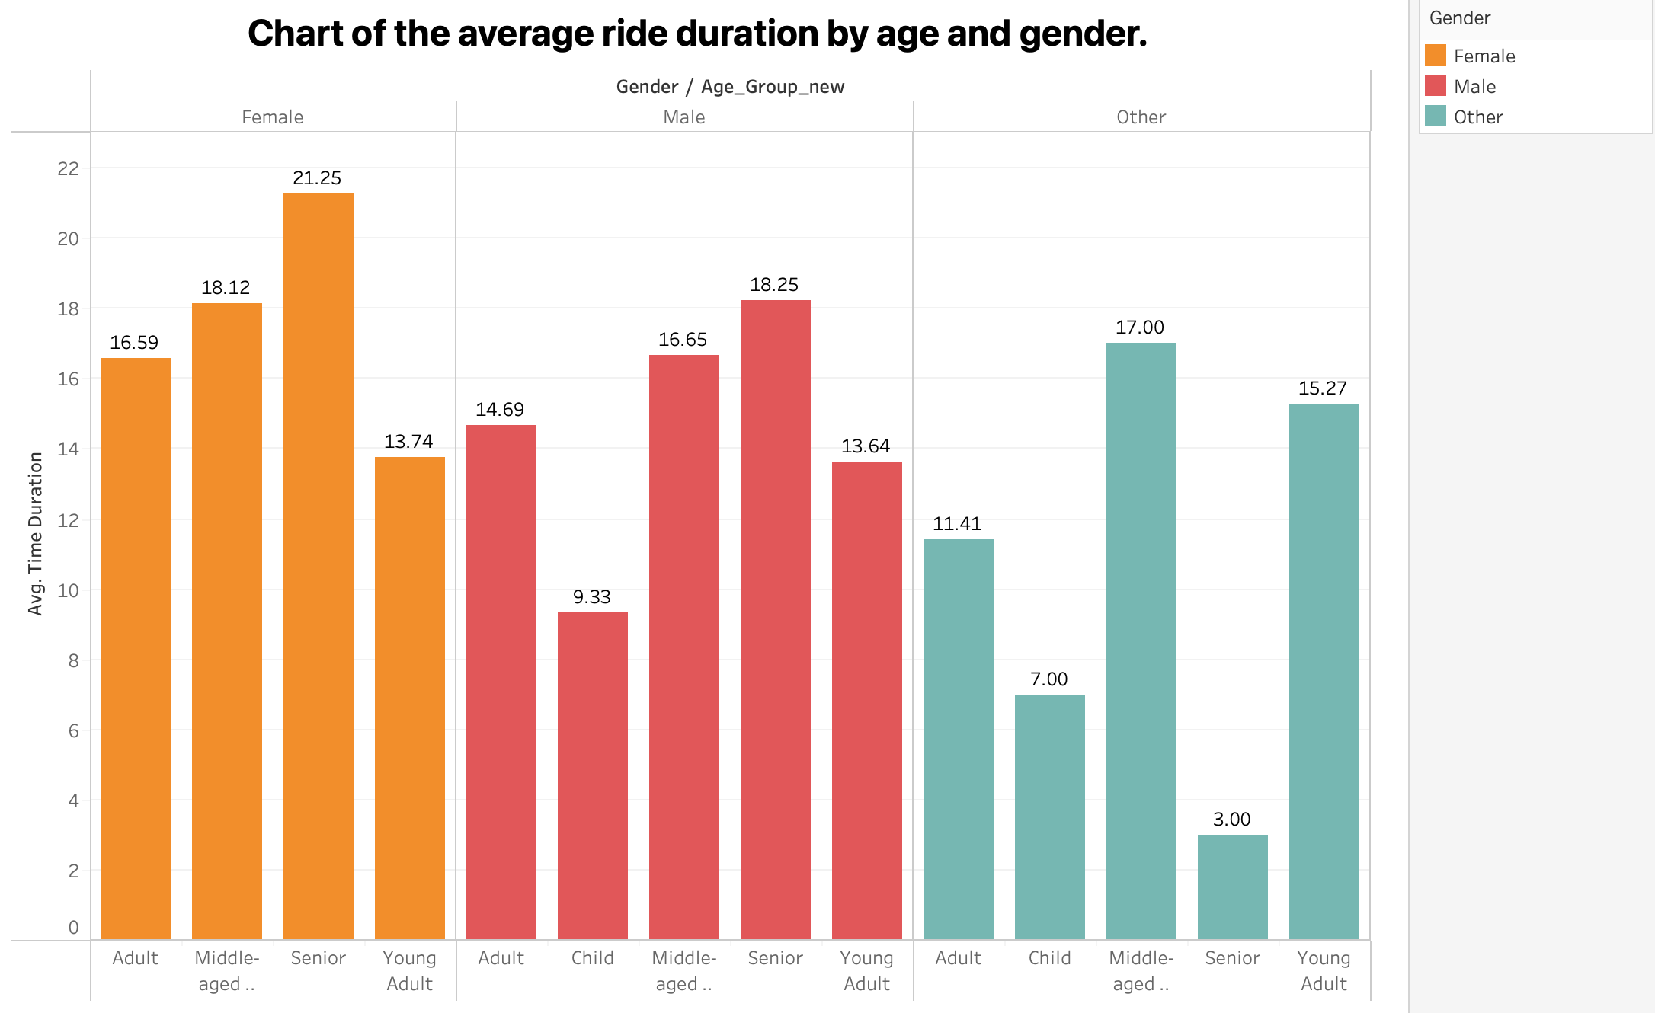
Data Visualization
Key Findings –
Average trip time in female senior age group is higher than all the age groups in females.
Average trip time in female young adult is lower than all the age groups in female.
Average trip time in male senior age group is higher than all the age groups in male.
Average trip time in male child age group is lower than all the age groups in male followed by young adults.
Average trip time in middle-aged age group is higher than all other age groups in other gender category.
Average trip time in senior age group is lower than all other age groups in other gender category.

Slide 9
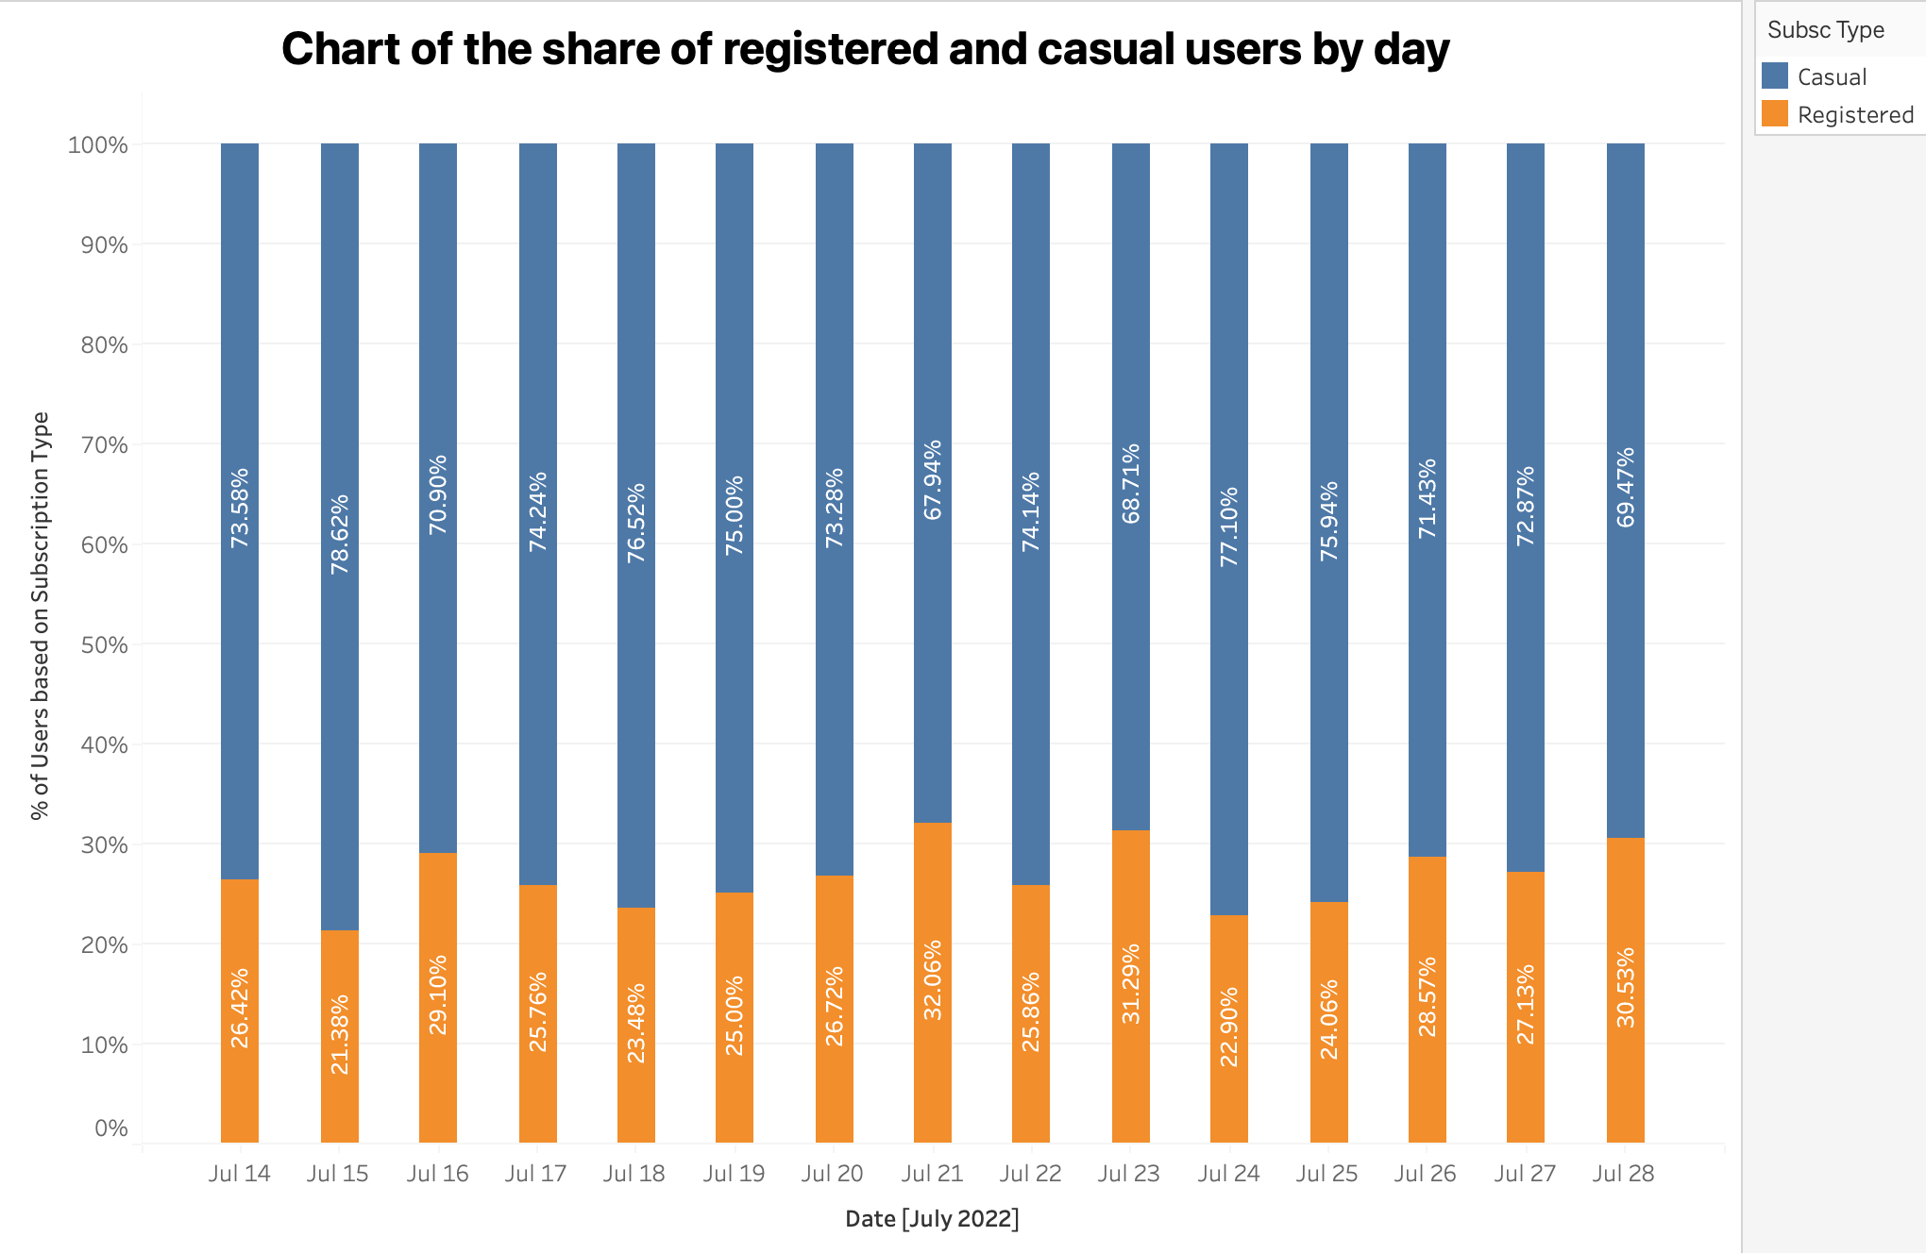
Key Findings –
From this graph, we can infer that the share of the casual users is higher than that of registered users by day

Slide 10
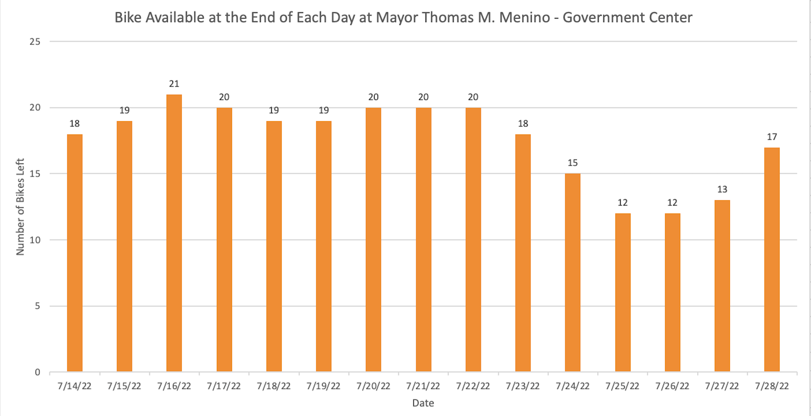
Key Findings –
Maximum number of bikes available is on July,16
Minimum number of bikes available on July, 25 and July, 26

Slide 11
THANK YOU

